Slide 1


Slide 2
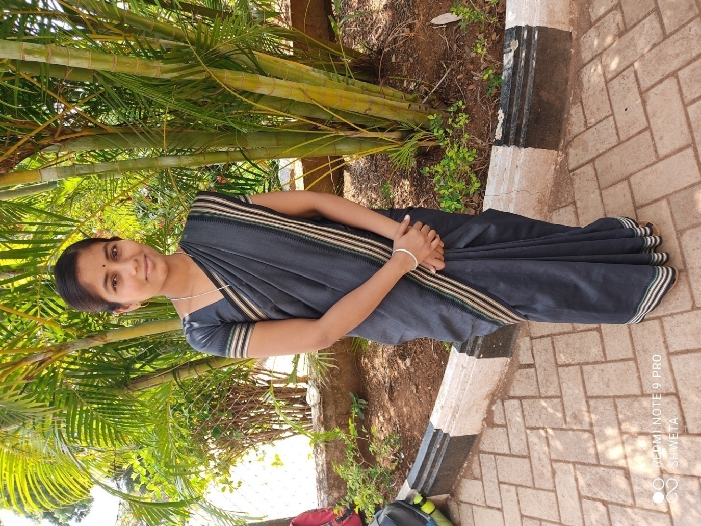
Purchase Manager
Name: Geeta

Slide 3


Slide 4
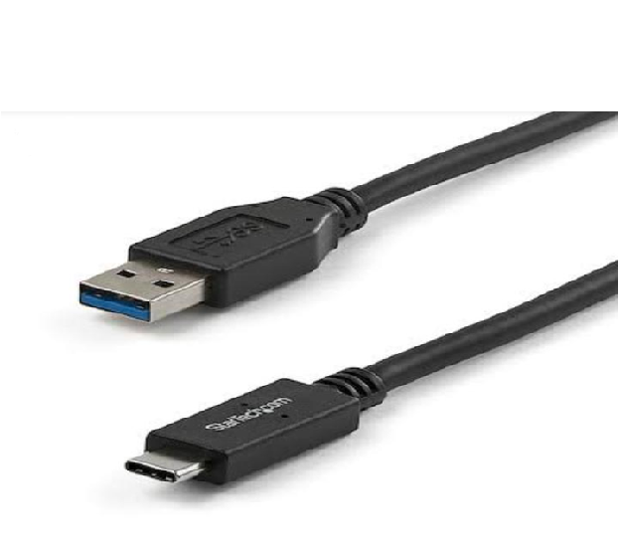
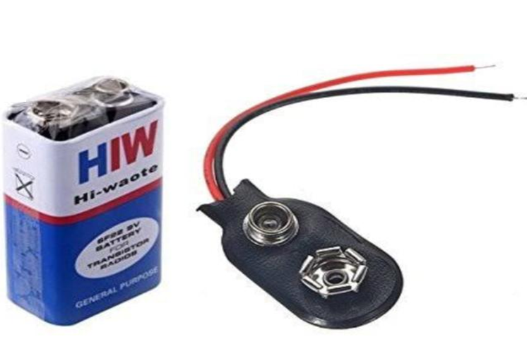
USB
₹100 (1)
Battery
₹20 (1)

Slide 5
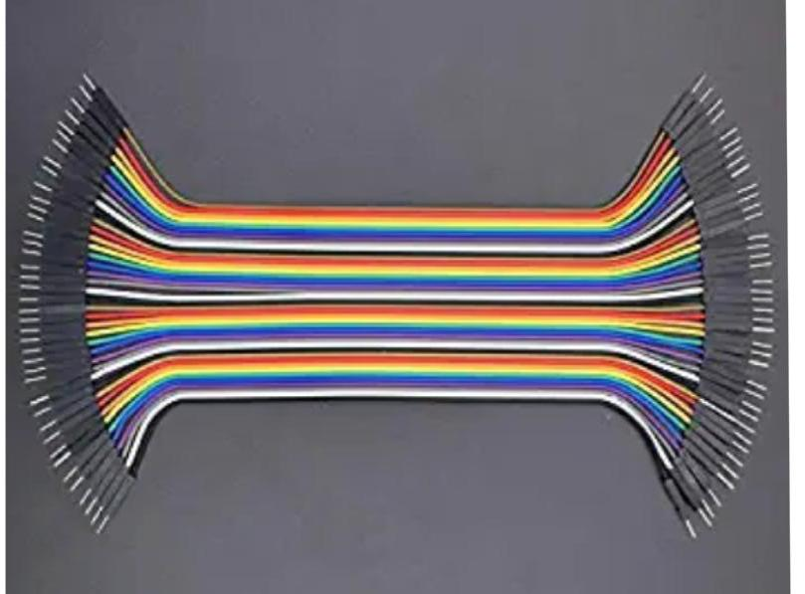
Jumper Wires
₹49(13)

Slide 6
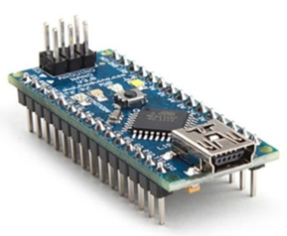
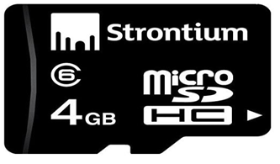
SD Card
₹175(1)
Arduino Nano
₹1,614(1)

Slide 7

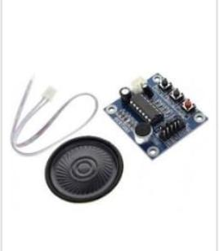
Speakers
₹140(1)
Gloves
₹80 (2)

Slide 8
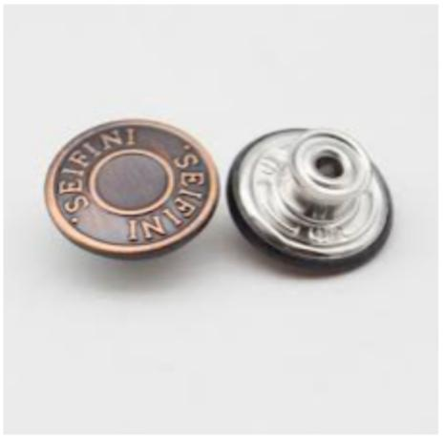
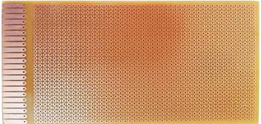
PCB ₹30 (1)
Cooper Buttons ₹104 (13*8)

Slide 9
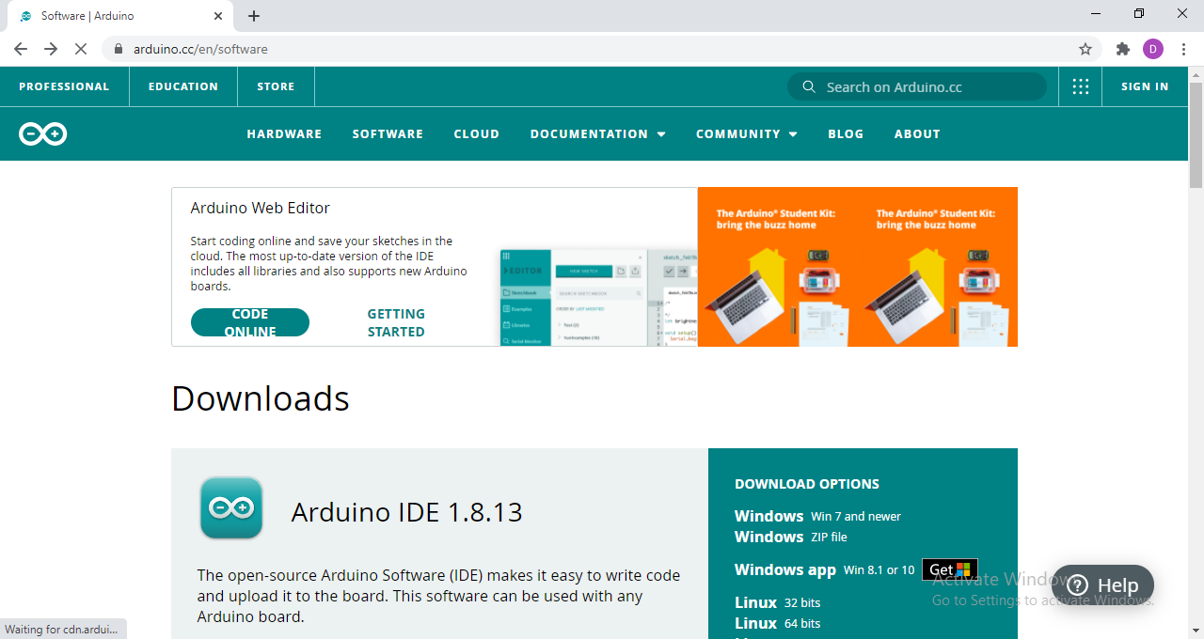
Software Requirement
Arduino IDE
(Integrated Development Environment)
Free Of Cost

Slide 10

Suppliers
Product | Supplier 1 | Amount (₹) | Supplier 2 | Amount (₹)
USB | SAR Enterprises | 100 | EGADGET Ltd | 219
JUMPER WIRES | Robotbanao Ltd | 49 | Techleads EXIM Private Ltd | 56
BATTERY | Laxmi Crafts | 20 | Apparino Retail Private Ltd | 50
ARDUINO NANO | DS Robotics | 1614 | Robo Craze Co. | 1890
SD CARD | Shri Ambe Computers | 175 | J P W Mobile Accessories | 190
SPEAKER | Bhalla Enterprises | 140 | In. Perfect Ltd. | 200
GLOVE | Digi Foot | 80 | Safe Yura | 99
PCB | My Technocare | 30 | Jre's | 72
SENSOR BUTTONS | Aaryason Enterprise | 104 | Eagle-mart | 159

Slide 11
Supplier Terms and Conditions
Payment to be made in/ on the date as specified.
If payment delays, interest rates are applicable.
In case of any defects in materials, it should be returned within original packages.

Slide 12
Terms &Conditions
to Suppliers
Raw materials are to be supplied at proper time.
Safety of raw materials is the sole responsibility of the supplier unless and until they reach the store.
Raw materials are subject to replacement in case they don’t adhere to the quality prescribed.

Slide 13
